Slide 1
Stage 1 Literacy and Numeracy Workshop

Slide 2
Guided Reading
This occurs on a daily basis in all Year 1 and 2 classes.
Small groups of children are explicitly taught reading and comprehension strategies by the class teacher.
Groups are usually formed according to the child’s individual instructional level - 90-95% accuracy in reading. This is always higher than their home reader level - 95-100% accuracy
During this time the class teacher will listen to all individuals read and will monitor their success.

Slide 3

Home reading
This is meant to be an enjoyable time where
you recognise your child’s success and
enthusiasm for reading.
Home readers are sent home each night.
The level of home reader sent home is meant to be easy for your child to promote success and increase their confidence.
Parents can support their children’s reading by :
- being encouraging
- discussing the story with their child
- giving the child time to work out unknown words
- model good reading by reading alternate pages
( refer to your child’s reading log book for further tips)

Slide 4
Questioning techniques
Here, Hidden and Head Hyperlink
Pull your finger across the word
Stretch out all the sounds you see
Now pull it all together
Does it Look right?
Does it Sound right?
Does it Make Sense?

Slide 5
Writing
Sight Word knowledge is not only important in reading but also in writing. (words that should be instantly recognised, unable to be sounded out, frequently used words)
Success in weekly spelling tests is important, but the ability to transfer this knowledge into their own writing is more imperative.
Quality of writing is far more important than Quantity

Slide 6
Writing help at home
Ensure your child has a good grasp of sight words – in weekly spelling and also in homework booklets. Constantly refer to these to maximise retention.
Encourage your child to write things at home ie: lists, letters, stories, recounts about outings/holidays. Make it fun – send letters and stories to friends and relations.
Edit work together, encourage them to self correct. Encourage them to attempt to write a word before seeking assistance.
Model good writing habits. Let them see you
writing and editing.
Internet writing activities – Writing fun http://www.writingfun.com/

Slide 7

Working Mathematically
Students ask questions and use objects, diagrams and technology to explore mathematical problems.
They link mathematical ideas and use everyday language, some mathematical language and diagrams to explain how answers were obtained.

Slide 8
Number
Students count, order, read and write numbers up to 999
They use a range of mental strategies, informal recording methods and materials to add, subtract, multiply and divide.
They model and describe objects and collections divided into halves and quarters.
Students sort, order and count money and recognise and describe the element of chance in familiar activities.

Slide 9
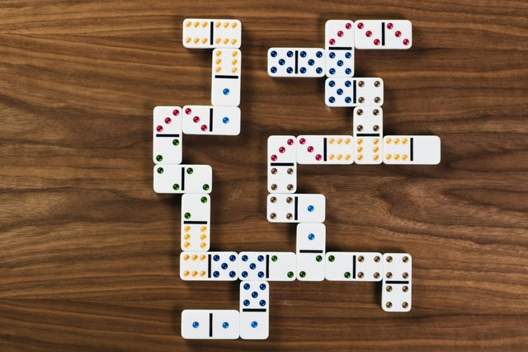
Patterns and Algebra
Students describe, create and continue a variety of number patterns and relate addition and subtraction facts to at least 20.

Slide 10
Measurement and Data
Students estimate, measure, compare and record using informal units for length, area, volume, capacity and mass.
They recognise the need for formal units of length and use the metre and centimetre to measure length and distance.
Students use a calendar to identify the date and name and order the months and the seasons of the year.

Slide 11
Measurement and Data
They use informal units to compare and order the duration of events and tell the time on the half-hour.
Students gather, organise, display and interpret data using column and picture graphs.

Slide 12


SPACE AND GEOMETRY
Students identify, describe, sort and model particular 3D objects and 2D shapes.
They represent and describe the position of objects.

Slide 13
How to help at home
http://k6.boardofstudies.nsw.edu.au/go/parents/#curriculum-overview
http://k6.boardofstudies.nsw.edu.au/go/mathematics
http://www.ixl.com/math/practice/grade-2-skip-counting
http://www.ictgames.com/
http://www.smartkiddies.com.au/
Children develop their understanding of maths best through their own experiences, activities and games.
Help your children become aware of numbers by counting everything: count money, change, items on a shopping list, spoons in the drawer.
Encourage children to measure and weigh in real-life situations. Use informal measurements eg: footsteps, before using rulers and tape measures.
Remember learn as they grow – let them use counters, hundreds charts, etc if they need them to work out answers.
Remember that all the talking, listening, questioning, reading, writing, collecting, measuring, making and observing that you do at home, is encouraging your child’s curiosity about maths and developing their problem-solving skills.

